Slide 1

Notes:
Lecture slides prepared for “Computer Security: Principles and Practice”, 3/e, by William Stallings and Lawrie Brown, Chapter 21 “Public-Key Cryptography and Message Authentication”.

Slide 2

Chapter 21
Public-Key Cryptography and Message Authentication
Notes:
This chapter provides technical detail on the topics introduced in Sections 2.2
through 2.4 .

Slide 3
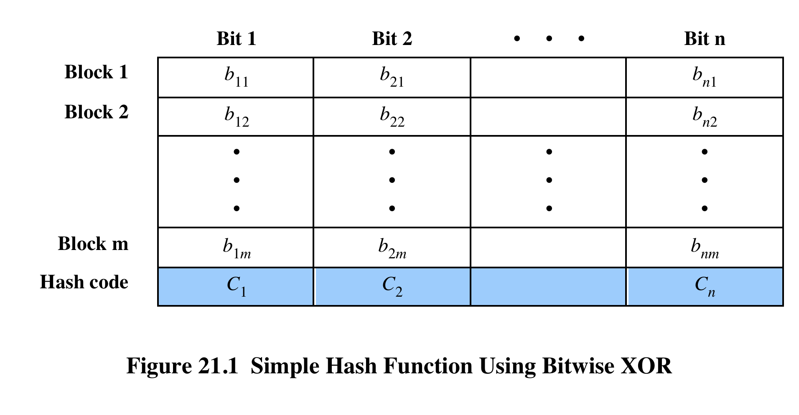
Notes:
The one-way hash function, or secure hash function, is important not only in
message authentication but also in digital signatures. The requirements for and
security of secure hash functions are discussed in Section 2.2 . Here, we look at
several hash functions, concentrating on perhaps the most widely used family of
hash functions: SHA.
All hash functions operate using the following general principles. The input
(message, file, etc.) is viewed as a sequence of n -bit blocks. The input is processed
one block at a time in an iterative fashion to produce an n -bit hash function.
One of the simplest hash functions is the bit-by-bit exclusive-OR (XOR) of
every block. This can be expressed as follows:
C_{i} = b_{i1} ⊕ b_{i2} ⊕ . . . ⊕ b_{im}
Figure 21.1 illustrates this operation; it produces a simple parity for each bit
position and is known as a longitudinal redundancy check. It is reasonably effective
for random data as a data integrity check. Each n -bit hash value is equally likely.
Thus, the probability that a data error will result in an unchanged hash value is 2^{-n}.
With more predictably formatted data, the function is less effective. For example, in
most normal text files, the high-order bit of each octet is always zero. So if a 128-bit
hash value is used, instead of an effectiveness of 2⁻¹²⁸, the hash function on this type
of data has an effectiveness of 2⁻¹¹².

Slide 4
Secure Hash Algorithm (SHA)
SHA was originally developed by NIST
Published as FIPS 180 in 1993
Was revised in 1995 as SHA-1
Produces 160-bit hash values
NIST issued revised FIPS 180-2 in 2002
Adds 3 additional versions of SHA
SHA-256, SHA-384, SHA-512
With 256/384/512-bit hash values
Same basic structure as SHA-1 but greater security
In 2005 NIST announced the intention to phase out approval of SHA-1 and move to a reliance on the other SHA versions by 2010
Notes:
The Secure Hash Algorithm (SHA) was developed by the National Institute of
Standards and Technology (NIST) and published as a federal information processing
standard (FIPS 180) in 1993; a revised version was issued as FIPS 180-1 in 1995
and is generally referred to as SHA-1. SHA-1 is also specified in RFC 3174, which
essentially duplicates the material in FIPS 180-1 but adds a C code implementation.
SHA-1 produces a hash value of 160 bits. In 2002, NIST produced a revision
of the standard, FIPS 180-2, that defined three new versions of SHA, with hash
value lengths of 256, 384, and 512 bits, known as SHA-256, SHA-384, and SHA-512
( Table 21.1 ). Collectively, these hash algorithms are known as SHA-2 . These new
versions have the same underlying structure and use the same types of modular
arithmetic and logical binary operations as SHA-1. In 2005, NIST announced the
intention to phase out approval of SHA-1 and move to a reliance on the other SHA
versions by 2010. Shortly thereafter, a research team described an attack in which
two separate messages could be found that deliver the same SHA-1 hash using 2 ⁶⁹
operations, far fewer than the 2 ⁸⁰ operations previously thought needed to find a
collision with an SHA-1 hash [WANG05]. This result should hasten the transition
to the other versions of SHA.
In this section, we provide a description of SHA-512. The other versions are
quite similar. The algorithm takes as input a message with a maximum length of
less than 2 ¹²⁸ bits and produces as output a 512-bit message digest. The input is
processed in 1024-bit blocks.

Slide 5
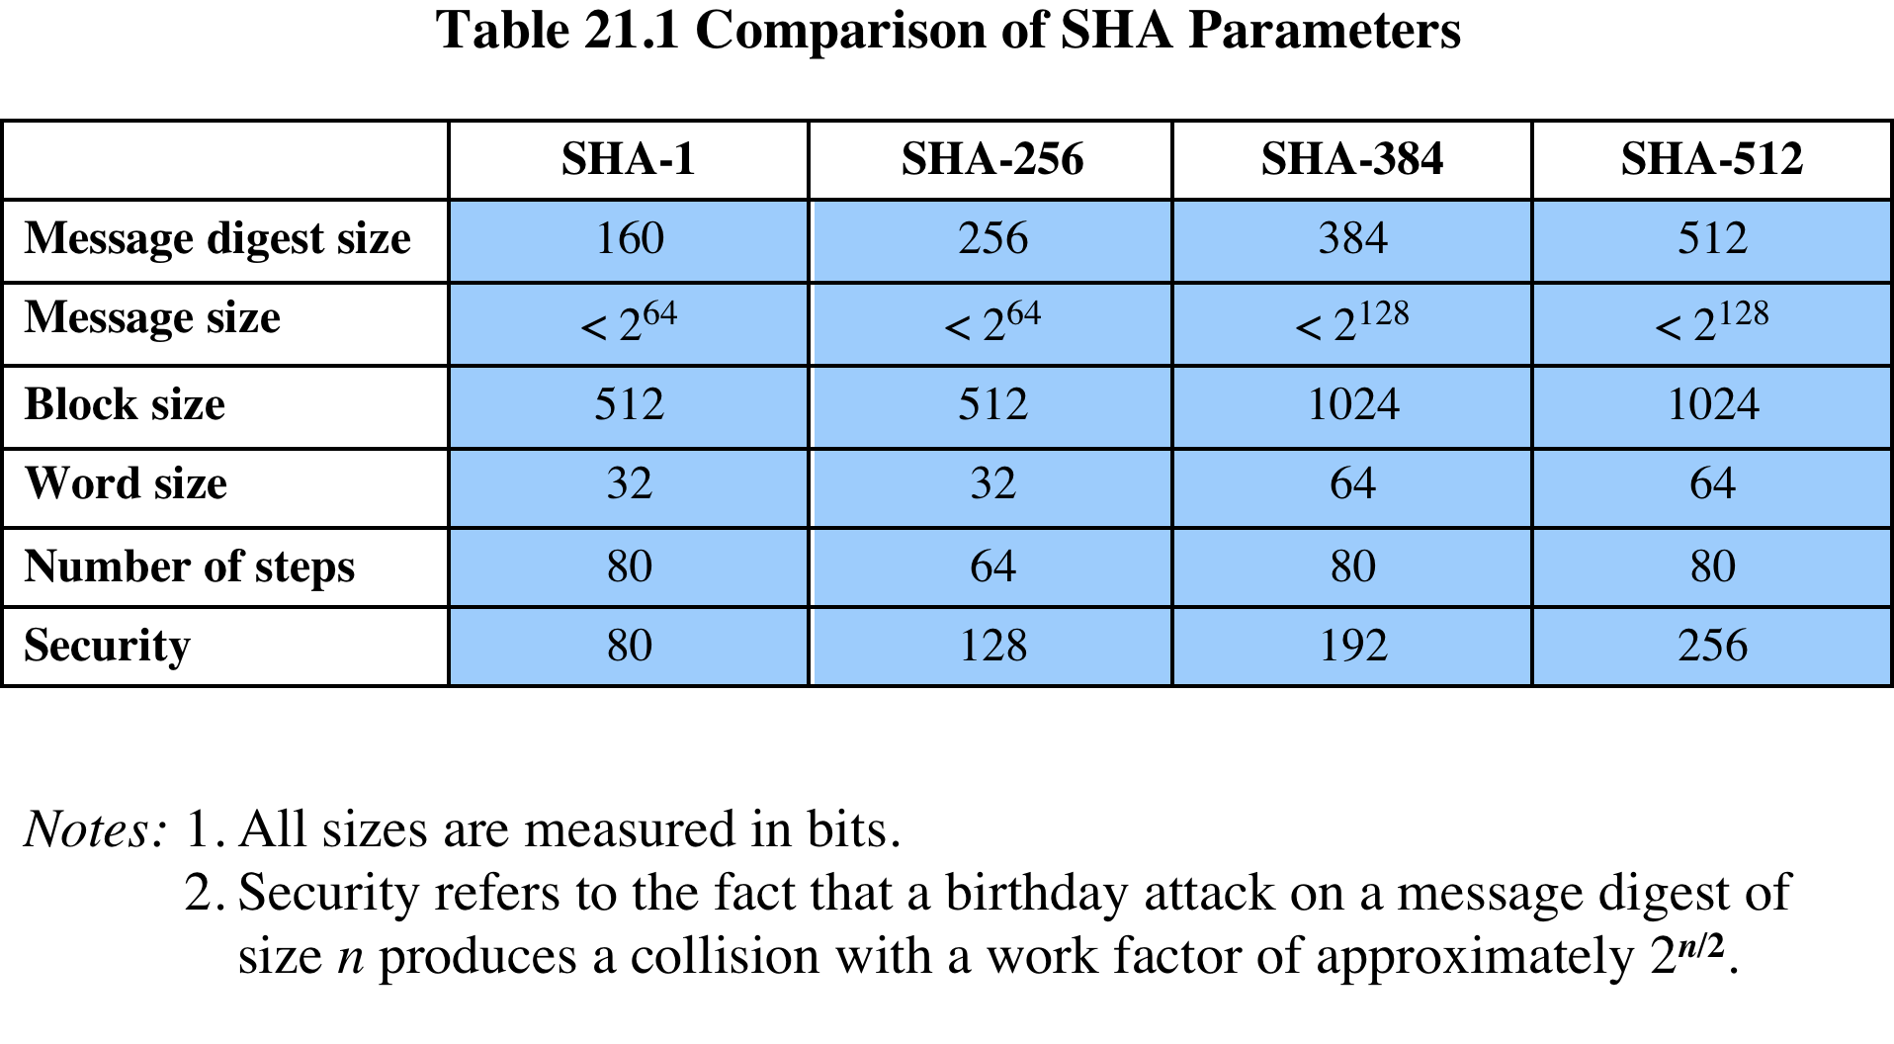
Notes:
Table 21.1
Comparison of SHA parameters.

Slide 6
Notes:
Figure 21.2 depicts the overall processing of a message
to produce a digest. The processing consists of the following steps:
• Step 1: Append padding bits: so that message length is congruent to 896 modulo 1024 [length ≡ 896 (mod 1024)]. The padding consists of a single 1-bit followed by the necessary number of 0-bits.
• Step 2: Append length: as a block of 128 bits being an unsigned 128-bit integer length of the original message (before padding).
• Step 3: Initialize hash buffer: to the specified 64-bit integer values (see text).
• Step 4: Process the message in 1024-bit (128-word) blocks, which forms the heart of the algorithm, being a module, labeled F in this figure, that consists of 80 rounds. The logic is described on the next slide.
• Step 5: Output the final hash buffer value as the resulting hash

Slide 7
Notes:
Each round takes as input the 512-bit buffer value abcdefgh, and updates the contents of the buffer. At input to the first round, the buffer has the value of the intermediate hash value, H_{i–1}. Each round t makes use of a 64-bit value W_{t}, derived from the current 1024-bit block being processed (M_{i}). Each round also makes use of an additive constant K_{t}, where 0 ≤ t ≤ 79 indicates one of the 80 rounds. These words represent the first sixty-four bits of the fractional parts of the cube roots of the first eighty prime numbers. The constants provide a “randomized” set of 64-bit patterns, which should eliminate any regularities in the input data. The operations performed during a round consist of circular shifts, and primitive Boolean functions based on AND, OR, NOT, and XOR.
The output of the eightieth round is added to the input to the first round (H_{i–1}) to produce H_{i}. The addition is done independently for each of the eight words in the buffer with each of the corresponding words in H_{i–1}, using addition modulo 2⁶⁴.

Slide 8
SHA-3
SHA-2 shares same structure and mathematical operations as its predecessors and causes concern
Due to time required to replace SHA-2 should it become vulnerable, NIST announced in 2007 a competition to produce SHA-3
Requirements:
Must support hash value lengths of 224, 256,384, and 512 bits
Algorithm must process small blocks at a time instead of requiring the entire message to be buffered in memory before processing it
Notes:
SHA-2, particularly the 512-bit version, would appear to provide unassailable
security. However, SHA-2 shares the same structure and mathematical operations
as its predecessors, and this is a cause for concern. Because it will take years to find
a suitable replacement for SHA-2, should it become vulnerable, NIST decided to
begin the process of developing a new hash standard.
Accordingly, NIST announced in 2007 a competition to produce the next
generation NIST hash function, to be called SHA-3. The basic requirements that
must be satisfied by any candidate for SHA-3 are the following.
1. It must be possible to replace SHA-2 with SHA-3 in any application by a simple
drop-in substitution. Therefore, SHA-3 must support hash value lengths of
224, 256, 384, and 512 bits.
2. SHA-3 must preserve the online nature of SHA-2. That is, the algorithm must
process comparatively small blocks (512 or 1024 bits) at a time instead of
requiring that the entire message be buffered in memory before processing it.

Slide 9
HMAC
Interest in developing a MAC derived from a cryptographic hash code
Cryptographic hash functions generally execute faster
Library code is widely available
SHA-1 was not deigned for use as a MAC because it does not rely on a secret key
Issued as RFC2014
Has been chosen as the mandatory-to-implement MAC for IP security
Used in other Internet protocols such as Transport Layer Security (TLS) and Secure Electronic Transaction (SET)
Notes:
In this section, we look at the hash-code approach to message authentication.
Appendix E looks at message authentication based on block ciphers. In recent years,
there has been increased interest in developing a MAC derived from a cryptographic
hash code, such as SHA-1. The motivations for this interest are as follows:
• Cryptographic hash functions generally execute faster in software than
conventional encryption algorithms such as DES.
• Library code for cryptographic hash functions is widely available.
A hash function such as SHA-1 was not designed for use as a MAC and
cannot be used directly for that purpose because it does not rely on a secret key.
There have been a number of proposals for the incorporation of a secret key
into an existing hash algorithm. The approach that has received the most support
is HMAC [BELL96]. HMAC has been issued as RFC 2104, has been chosen as
the mandatory-to-implement MAC for IP Security, and is used in other Internet
protocols, such as Transport Layer Security (TLS, soon to replace Secure Sockets
Layer) and Secure Electronic Transaction (SET).

Slide 10
HMAC Design Objectives
To use, without modifications, available hash functions
To allow for easy replaceability of the embedded hash function in case faster or more secure hash functions are found or required
To preserve the original performance of the hash function without incurring a significant degradation
To use and handle keys in a simple way
To have a well-understood cryptographic analysis of the strength of the authentication mechanism based on reasonable assumptions on the embedded hash function
Notes:
RFC 2104 lists the following design objectives for HMAC:
• To use, without modifications, available hash functions—in particular, hash
functions that perform well in software, and for which code is freely and
widely available
• To allow for easy replaceability of the embedded hash function in case faster
or more secure hash functions are found or required
• To preserve the original performance of the hash function without incurring a
significant degradation
• To use and handle keys in a simple way
• To have a well-understood cryptographic analysis of the strength of the
authentication mechanism based on reasonable assumptions on the embedded
hash function
The first two objectives are important to the acceptability of HMAC. HMAC
treats the hash function as a “black box.” This has two benefits. First, an existing
implementation of a hash function can be used as a module in implementing
HMAC. In this way, the bulk of the HMAC code is prepackaged and ready to use
without modification. Second, if it is ever desired to replace a given hash function
in an HMAC implementation, all that is required is to remove the existing hash
function module and drop in the new module. This could be done if a faster
hash function were desired. More important, if the security of the embedded hash
function were compromised, the security of HMAC could be retained simply by
replacing the embedded hash function with a more secure one.
The last design objective in the preceding list is, in fact, the main advantage
of HMAC over other proposed hash-based schemes. HMAC can be proven secure
provided that the embedded hash function has some reasonable cryptographic
strengths. We return to this point later in this section, but first we examine the
structure of HMAC.

Slide 11
Notes:
Figure 21.4 illustrates the overall operation of HMAC.
In words:
1. Append zeros to the left end of K to create a b-bit string K⁺ (e.g., if K is of length 160 bits and b = 512, then K will be appended with 44 zero bytes 0x00).
2. XOR (bitwise exclusive-OR) K⁺ with ipad to produce the b-bit block S_{i}.
3. Append M to S_{i}.
4. Apply H to the stream generated in step 3.
5. XOR K⁺ with opad to produce the b-bit block S_{o}.
6. Append the hash result from step 4 to S_{o}.
7. Apply H to the stream generated in step 6 and output the result.
Note that the XOR with ipad results in flipping one-half of the bits of K .
Similarly, the XOR with opad results in flipping one-half of the bits of K , but a
different set of bits. In effect, by passing S _{i} and S _{o} through the hash algorithm, we
have pseudorandomly generated two keys from K .
HMAC should execute in approximately the same time as the embedded hash
function for long messages. HMAC adds three executions of the basic hash function
(for S _{i ,} S _{o} , and the block produced from the inner hash).

Slide 12
Security of HMAC
Security depends on the cryptographic strength of the underlying hash function
For a given level of effort on messages generated by a legitimate user and seen by the attacker, the probability of successful attack on HMAC is equivalent to one of the following attacks on the embedded hash function:
Either attacker computes output even with random secret IV
Brute force key O(2^{n}), or use birthday attack
Or attacker finds collisions in hash function even when IV is random and secret
ie. find M and M' such that H(M) = H(M')
Birthday attack O( 2n/2)
MD5 secure in HMAC since only observe
Notes:
The security of any MAC function based on an embedded hash function depends
in some way on the cryptographic strength of the underlying hash function. The
appeal of HMAC is that its designers have been able to prove an exact relationship
between the strength of the embedded hash function and the strength
of HMAC.
The security of a MAC function is generally expressed in terms of the probability
of successful forgery with a given amount of time spent by the forger and a
given number of message-MAC pairs created with the same key. In essence, it is
proved in [BELL96] that for a given level of effort (time, message-MAC pairs) on
messages generated by a legitimate user and seen by the attacker, the probability
of successful attack on HMAC is equivalent to one of the following attacks on the
embedded hash function:
1. The attacker is able to compute an output of the compression function even
with an IV that is random, secret, and unknown to the attacker.
2. The attacker finds collisions in the hash function even when the IV is random
and secret.
In the first attack, we can view the compression function as equivalent to the
hash function applied to a message consisting of a single b -bit block. For this attack,
the IV of the hash function is replaced by a secret, random value of n bits. An attack
on this hash function requires either a brute-force attack on the key, which is a level
of effort on the order of 2 ^{n} , or a birthday attack, which is a special case of the second
attack, discussed next.
In the second attack, the attacker is looking for two messages M and M’ that
produce the same hash: H(M’ = H(M’) . This is the birthday attack mentioned
previously. We have stated that this requires a level of effort of 2 ^{n /2} for a hash
length of n . On this basis, the security of MD5 is called into question, because a
level of effort of 2 ⁶⁴ looks feasible with today’s technology. Does this mean that
a 128-bit hash function such as MD5 is unsuitable for HMAC? The answer is no,
because of the following argument. To attack MD5, the attacker can choose any
set of messages and work on these offline on a dedicated computing facility to
find a collision. Because the attacker knows the hash algorithm and the default
IV, the attacker can generate the hash code for each of the messages that the
attacker generates. However, when attacking HMAC, the attacker cannot generate
message/code pairs offline because the attacker does not know K . Therefore,
the attacker must observe a sequence of messages generated by HMAC under the
same key and perform the attack on these known messages. For a hash code length
of 128 bits, this requires 2 ⁶⁴ observed blocks (2 ⁷² bits) generated using the same
key. On a 1-Gbps link, one would need to observe a continuous stream of messages
with no change in key for about 150,000 years in order to succeed. Thus, if speed is
a concern, it is fully acceptable to use MD5 rather than SHA as the embedded hash
function for HMAC.

Slide 13
RSA Public-Key Encryption
By Rivest, Shamir & Adleman of MIT in 1977
Best known and widely used public-key algorithm
Uses exponentiation of integers modulo a prime
Encrypt: C = Me mod n
Decrypt: M = C^{d} mod n = (Me)^{d} mod n = M
Both sender and receiver know values of n and e
Only receiver knows value of d
Public-key encryption algorithm with public key PU = {e, n} and private key PR = {d, n}
Notes:
Perhaps the most widely used public-key algorithms are RSA and Diffie-Hellman.
One of the first public-key schemes was developed in 1977 by Ron Rivest, Adi Shamir, and Len Adleman at MIT and first published in 1978 [RIVE78]. The RSA scheme has since that time reigned supreme as the most widely accepted and implemented approach to public-key encryption. RSA is a block cipher in which the plaintext and ciphertext are integers between 0 and n – 1 for some n.
Encryption and decryption are of the following form, for some plaintext block M and ciphertext block C:
C = Me mod n
M = C^{d} mod n = (Me)^{d} mod n = M^{ed} mod n
Both sender and receiver must know the values of n and e, and only the receiver knows the value of d. This is a public-key encryption algorithm with a public key of PU = {e, n} and a private key of PR = {d, n}. See text for details of how these values are derived, and their requirements.

Slide 14
Notes:
Figure 21.5 summarizes the RSA algorithm. Begin by selecting two prime numbers, p and q and calculating their product n, which is the modulus for encryption and decryption. Next, we need the quantity Then select an integer e that is relatively prime to φ(n) [i.e., the greatest common divisor of e and φ(n) is 1]. Finally, calculate d as the multiplicative inverse of e, modulo φ(n). It can be shown that d and e have the desired properties.
Suppose that user A has published its public key and that user B wishes to send the message M to A. Then B calculates C = Me (mod n) and transmits C. On receipt of this ciphertext, user A decrypts by calculating M = C^{d} (mod n).

Slide 15
Notes:
An example from [SING99] is shown in Figure 21.6. For this example, the keys were generated as:
1. Select two prime numbers, p = 17 and q = 11.
2. Calculate n = pq = 17 × 11 = 187.
3. Calculate φ(n) = (p – 1)(q – 1) = 16 × 10 = 160.
4. Select e s.t. e is relatively prime to φ(n) = 160 and less than φ(n); we choose e = 7.
5. Determine d such that de mod 160 = 1 and d < 160. The correct value is d = 23, because 23 × 7 = 161 = (1 × 160) + 1.
The resulting keys are public key PU = {7, 187} and private key PR = {23, 187}. The example shows the use of these keys for a plaintext input of M = 88. For encryption, we need to calculate C = 88⁷ mod 187.

Slide 16
Security of RSA
Brute force
Involves trying all possible private keys
Mathematical attacks
There are several approaches, all equivalent in effort to factoring the product of two primes
Timing attacks
These depend on the running time of the decryption algorithm
Chosen ciphertext attacks
This type of attack exploits properties of the RSA algorithm
Notes:
Four possible approaches to attacking the RSA algorithm are:
• Brute force: This involves trying all possible private keys.
• Mathematical attacks: There are several approaches, all equivalent in effort to
factoring the product of two primes.
• Timing attacks: These depend on the running time of the decryption algorithm.
• Chosen ciphertext attacks: This type of attack exploits properties of the RSA algorithm. A discussion of this attack is beyond the scope of this book.

Slide 17
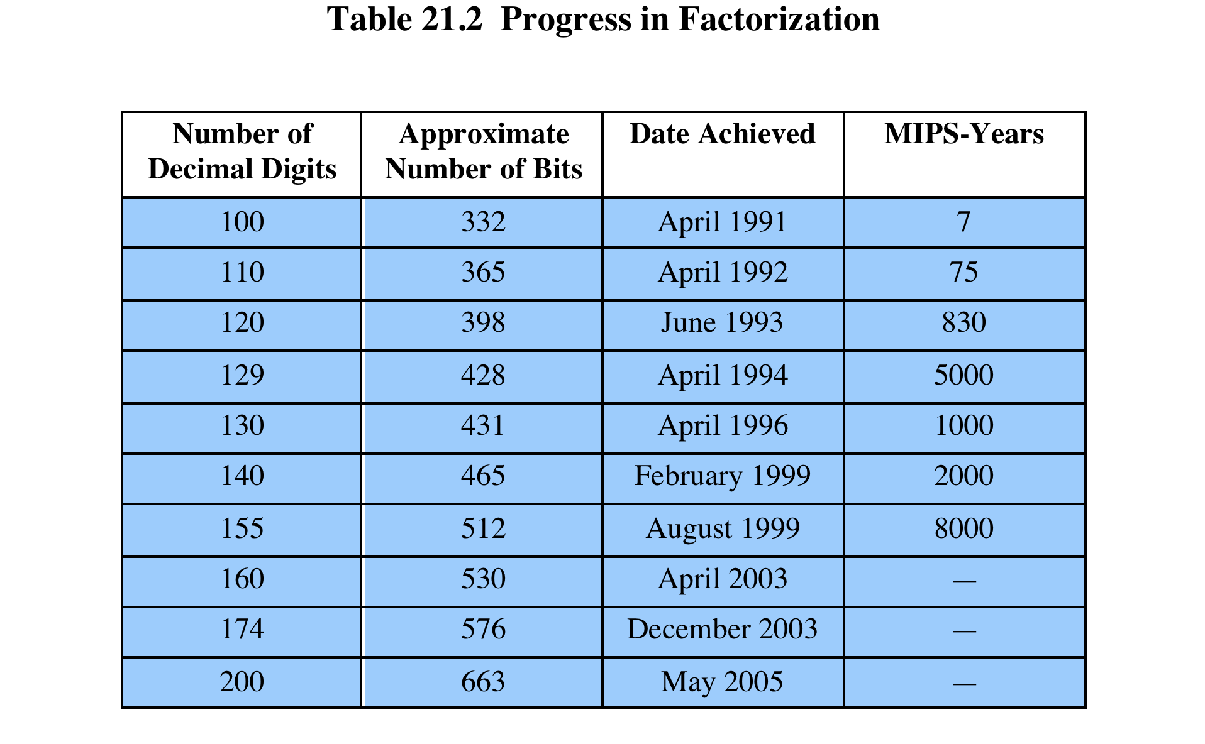
Notes:
For a large n with large prime factors, factoring is a hard problem, but not
as hard as it used to be. Just as it had done for DES, RSA Laboratories issued
challenges for the RSA cipher with key sizes of 100, 110, 120, and so on, digits. The
latest challenge to be met is the RSA-200 challenge with a key length of 200 decimal
digits, or about 663 bits. Table 21.2 shows the results to date. The level of effort is
measured in MIPS-years: a million-instructions-per-second processor running for
one year, which is about 3 * 10¹³ instructions executed (MIPS-year numbers not
available for last 3 entries).
A striking fact about Table 21.2 concerns the method used. Until the
mid-1990s, factoring attacks were made using an approach known as the quadratic
sieve. The attack on RSA-130 used a newer algorithm, the generalized number field
sieve (GNFS), and was able to factor a larger number than RSA-129 at only 20% of
the computing effort.
The threat to larger key sizes is twofold: the continuing increase in computing
power, and the continuing refinement of factoring algorithms. We have seen
that the move to a different algorithm resulted in a tremendous speedup. We can
expect further refinements in the GNFS, and the use of an even better algorithm is
also a possibility. In fact, a related algorithm, the special number field sieve (SNFS),
can factor numbers with a specialized form considerably faster than the generalized
number field sieve. It is reasonable to expect a breakthrough that would enable
a general factoring performance in about the same time as SNFS, or even better.
Thus, we need to be careful in choosing a key size for RSA. For the near future, a
key size in the range of 1024 to 2048 bits seems secure.
In addition to specifying the size of n , a number of other constraints have been
suggested by researchers. To avoid values of n that may be factored more easily, the
algorithm’s inventors suggest the following constraints on p and q :
1. p and q should differ in length by only a few digits. Thus, for a 1024-bit key
(309 decimal digits), both p and q should be on the order of magnitude of
10 ⁷⁵ to 10 ¹⁰⁰ .
2. Both (p - 1) and (q - 1) should contain a large prime factor.
3. gcd (p - 1, q - 1) should be small.
In addition, it has been demonstrated that if e < n and d < n^{1/4} , then d can be easily
determined [WIEN90].

Slide 18

Diffie-Hellman Key Exchange
First published public-key algorithm
By Diffie and Hellman in 1976 along with the exposition of public key concepts
Used in a number of commercial products
Practical method to exchange a secret key securely that can then be used for subsequent encryption of messages
Security relies on difficulty of computing discrete logarithms
Notes:
The first published public-key algorithm appeared in the seminal paper by Diffie
and Hellman that defined public-key cryptography [DIFF76] and is generally
referred to as Diffie-Hellman key exchange. A number of commercial products
employ this key exchange technique.
The purpose of the algorithm is to enable two users to exchange a secret key
securely that can then be used for subsequent encryption of messages. The algorithm
itself is limited to the exchange of the keys.
The Diffie-Hellman algorithm depends for its effectiveness on the difficulty of
computing discrete logarithms.

Slide 19
Notes:
The Diffie-Hellman key exchange algorithm is summarized in Figure 21.7. For this scheme, there are two publicly known numbers: a prime number q and an integer α that is a primitive root of q. Suppose the users A and B wish to exchange a key. User A selects a random integer X_{A} < q and computes . Similarly, user B independently selects a random integer X_{B} < q and computes . Each side keeps the X value private and makes the Y value available publicly to the other side. Users A and B compute the key as shown. These two calculations produce identical results, as shown in the text. The result is that the two sides have exchanged a secret value.
Furthermore, because X_{A} and X_{B} are private, an adversary only has the following ingredients to work with: q, α, Y_{A}, and Y_{B}. Thus, the adversary is forced to take a discrete logarithm to determine the key. For example, to determine the private key of user B, an adversary must compute: X_{B} = dlog_{α,q}(Y_{B}). The adversary can then calculate the key K in the same manner as user B calculates it.
The security of the Diffie-Hellman key exchange lies in the fact that, while it is relatively easy to calculate exponentials modulo a prime, it is very difficult to calculate discrete logarithms. For large primes, the latter task is considered infeasible.

Slide 20
Diffie-Hellman Example
Have
Prime number q = 353
Primitive root α = 3
A and B each compute their public keys
A computes Y_{A} = 3⁹⁷ mod 353 = 40
B computes Y_{B} = 3²³³ mod 353 = 248
Then exchange and compute secret key:
For A: K = (Y_{B})^{XA} mod 353 = 248⁹⁷ mod 353 = 160
For B: K = (Y_{A})^{XB} mod 353 = 40²³³ mod 353 = 160
Attacker must solve:
3ª mod 353 = 40 which is hard
Desired answer is 97, then compute key as B does
Notes:
Here is an example. Key exchange is based on the use of the prime number q = 353 and a primitive root of 353, in this case α = 3. A and B select secret keys X_{A} = 97 and X_{B} = 233, respectively. Each computes its public key:
A computes Y_{A} = 3⁹⁷ mod 353 = 40.
B computes Y_{B} = 3²³³ mod 353 = 248.
After they exchange public keys, each can compute the common secret key:
A computes K = (Y_{B})^{XA} mod 353 = 248⁹⁷ mod 353 = 160.
B computes K = (Y_{A})^{XB} mod 353 = 40²³³ mod 353 = 160.
We assume an attacker would have available the following information:
q = 353; α = 3; Y_{A} = 40; Y_{B} = 248
In this simple example, it would be possible by brute force to determine the secret key 160. In particular, an attacker E can determine the common key by discovering a solution to the equation 3ª mod 353 = 40 or the equation 3^{b} mod 353 = 248. The brute-force approach is to calculate powers of 3 modulo 353, stopping when the result equals either 40 or 248. The desired answer is reached with the exponent value of 97, which provides 3⁹⁷ mod 353 = 40.
With larger numbers, the problem becomes impractical.

Slide 21
Notes:
Figure 21.8 shows a simple protocol that makes use of the Diffie-Hellman calculation. Suppose that user A wishes to set up a connection with user B and use a secret key to encrypt messages on that connection. User A can generate a one-time private key X_{A}, calculate Y_{A}, and send that to user B. User B responds by generating a private value X_{B}, calculating Y_{B}, and sending Y_{B} to user A. Both users can now calculate the key. The necessary public values q and α would need to be known ahead of time. Alternatively, user A could pick values for q and α and include those in the first message.
As an example of another use of the Diffie-Hellman algorithm, suppose that a group of users (e.g., all users on a LAN) each generate a long-lasting private value X_{A} and calculate a public value Y_{A}. These public values, together with global public values for q and α, are stored in some central directory. At any time, user B can access user A's public value, calculate a secret key, and use that to send an encrypted message to user A. If the central directory is trusted, then this form of communication provides both confidentiality and a degree of authentication. Because only A and B can determine the key, no other user can read the message (confidentiality). Recipient A knows that only user B could have created a message using this key (authentication). However, the technique does not protect against replay attacks.

Slide 22
Man-in-the-Middle Attack
Attack is:
Darth generates private keys X_{D1} and X_{D2}, and their public keys Y_{D1} and Y_{D2}
Alice transmits Y_{A} to Bob
Darth intercepts Y_{A} and transmits Y_{D1} to Bob. Darth also calculates K2
Bob receives Y_{D1} and calculates K1
Bob transmits X_{A} to Alice
Darth intercepts X_{A} and transmits Y_{D2} to Alice. Darth calculates K1
Alice receives Y_{D2} and calculates K2
All subsequent communications compromised
Notes:
The protocol depicted in Figure 21.8 is insecure against a man-in-the-middle attack. Suppose Alice and Bob wish to exchange keys, and Darth is attacks as follows:
1. Darth generates two private keys X_{D1} and X_{D2}, and public keys Y_{D1} & Y_{D2}.
2. Alice transmits Y_{A} to Bob.
3. Darth intercepts Y_{A} and transmits Y_{D1} to Bob. Darth also calculates K2
4. Bob receives Y_{D1} and calculates K1.
5. Bob transmits X_{A} to Alice.
6. Darth intercepts X_{A} and transmits Y_{D2} to Alice. Darth calculates .
7. Alice receives Y_{D2} and calculates .
At this point, Bob and Alice think that they share a secret key, but instead Bob and Darth share secret key K1 and Alice and Darth share secret key K2. All future communication between Bob and Alice is compromised in the following way:
1. Alice sends an encrypted message M: E(K2, M).
2. Darth intercepts the encrypted message and decrypts it, to recover M.
3. Darth sends Bob E(K1, M) or E(K1, M'), where M' is any message. In the first case, Darth simply wants to eavesdrop on the communication without altering it. In the second case, Darth wants to modify the message going to Bob.
The key exchange protocol is vulnerable to such an attack because it does not authenticate the participants. This vulnerability can be overcome with the use of digital signatures and public-key certificates

Slide 23
Other Public-Key Algorithms
Digital Signature
Standard (DSS)
Elliptic-Curve Cryptography (ECC)
FIPS PUB 186
Makes use of SHA-1 and the Digital Signature Algorithm (DSA)
Originally proposed in 1991, revised in 1993 due to security concerns, and another minor revision in 1996
Cannot be used for encryption or key exchange
Uses an algorithm that is designed to provide only the digital signature function
Equal security for smaller bit size than RSA
Seen in standards such as IEEE P1363
Confidence level in ECC is not yet as high as that in RSA
Based on a mathematical construct known as the elliptic curve
Notes:
The National Institute of Standards and Technology (NIST) has published Federal Information Processing Standard FIPS PUB 186, known as the Digital Signature Standard (DSS). The DSS makes use of the SHA-1 and presents a new digital signature technique, the Digital Signature Algorithm (DSA). The DSS was originally proposed in 1991 and revised in 1993 in response to public feedback concerning the security of the scheme. There was a further minor revision in 1996. The DSS uses an algorithm that is designed to provide only the digital signature function. Unlike RSA, it cannot be used for encryption or key exchange.
The vast majority of the products and standards that use public-key cryptography for encryption and digital signatures use RSA. The bit length for secure RSA use has increased over recent years, and this has put a heavier processing load on applications using RSA. This burden has ramifications, especially for electronic commerce sites that conduct large numbers of secure transactions. Recently, a competing system has begun to challenge RSA: elliptic curve cryptography (ECC). Already, ECC is showing up in standardization efforts, including the IEEE P1363 Standard for Public-Key Cryptography.
The principal attraction of ECC compared to RSA is that it appears to offer equal security for a far smaller bit size, thereby reducing processing overhead. On the other hand, although the theory of ECC has been around for some time, it is only recently that products have begun to appear and that there has been sustained cryptanalytic interest in probing for weaknesses. Thus, the confidence level in ECC is not yet as high as that in RSA.
ECC is fundamentally more difficult to explain, and a full mathematical description is beyond the scope of this book. The technique is based on the use of a mathematical construct known as the elliptic curve.

Slide 24
Summary
Secure hash functions
Simple hash functions
The SHA secure hash function
SHA-3
Diffie-Hellman and other asymmetric algorithms
Diffie-Helman key exchange
Other public-key cryptography algorithms
The RSA public-key encryption algorithm
Description of the algorithm
The security of RSA
HMAC
HMAC design objectives
HMAC algorithm
Security of HMAC
Notes:
Chapter 21 summary.

